Slide 1
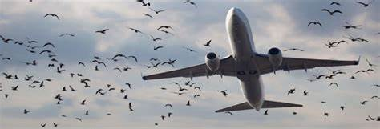
BIRD STRIKE ANALYSIS 2000-2011
By
Chethan g s

Slide 2
PROJECT OVERVIEW
This project includes an illustrative analysis on Bird Strikes between the years 2000 and 2011, and analysis attributes like Bird Strike occurrences, costs, and impacts across airlines, airports, and flight phases for aviation safety insights.
This project is performed using Tableau, and utilizes comprehensive data to identify patterns and trends in bird strikes, providing valuable information for mitigating future incidents.

Slide 3
PROBLEM STATEMENT
The goal of this project is to analyse the bird strike incidents happened between 2000-2011. To achieve the goal, we used a data set that is collected by FAA during 2000-2011. The objective of the project is to perform data visualization techniques to understand insights of the data. This project aims apply various Business Intelligence tools such as Tableau or Power BI to get a visual understanding of the data.

Slide 4
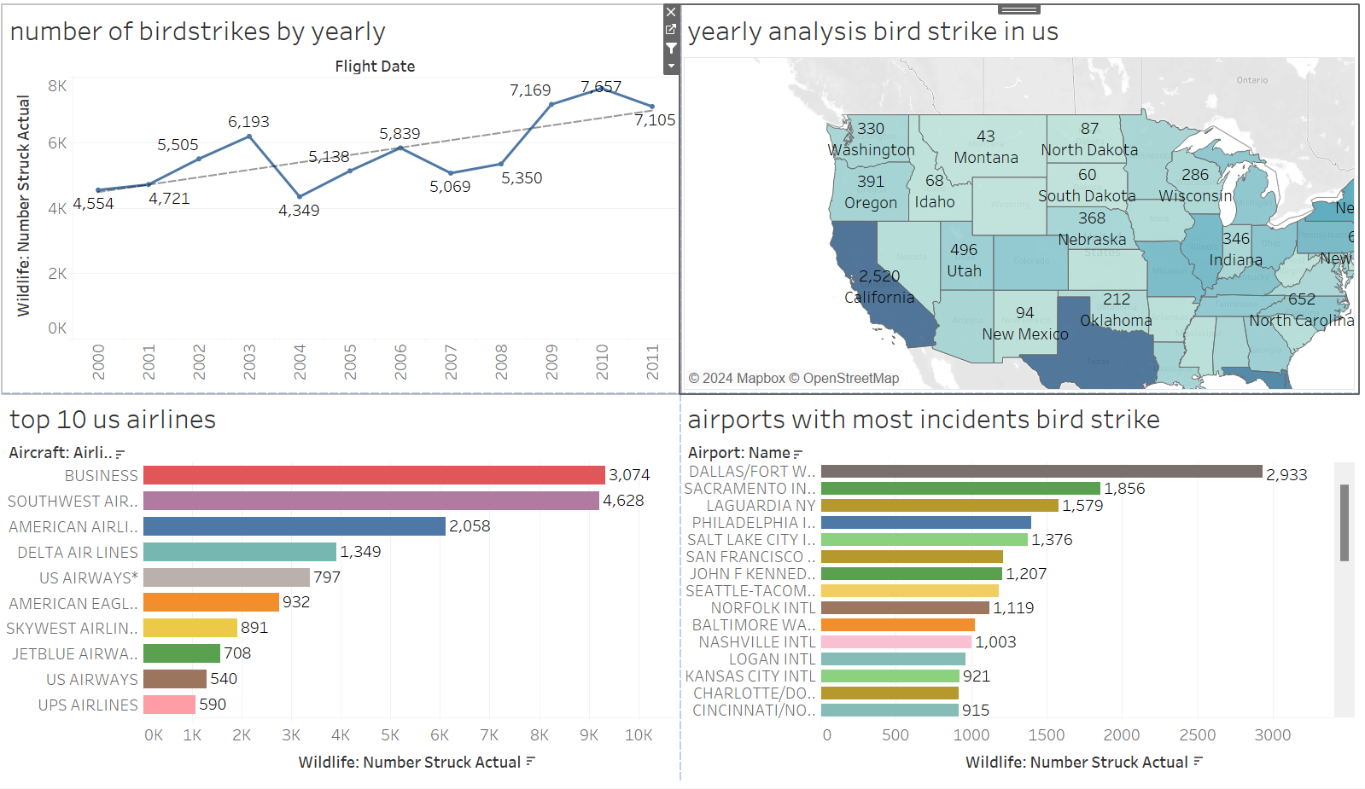
DASHBOARD 1

Slide 5
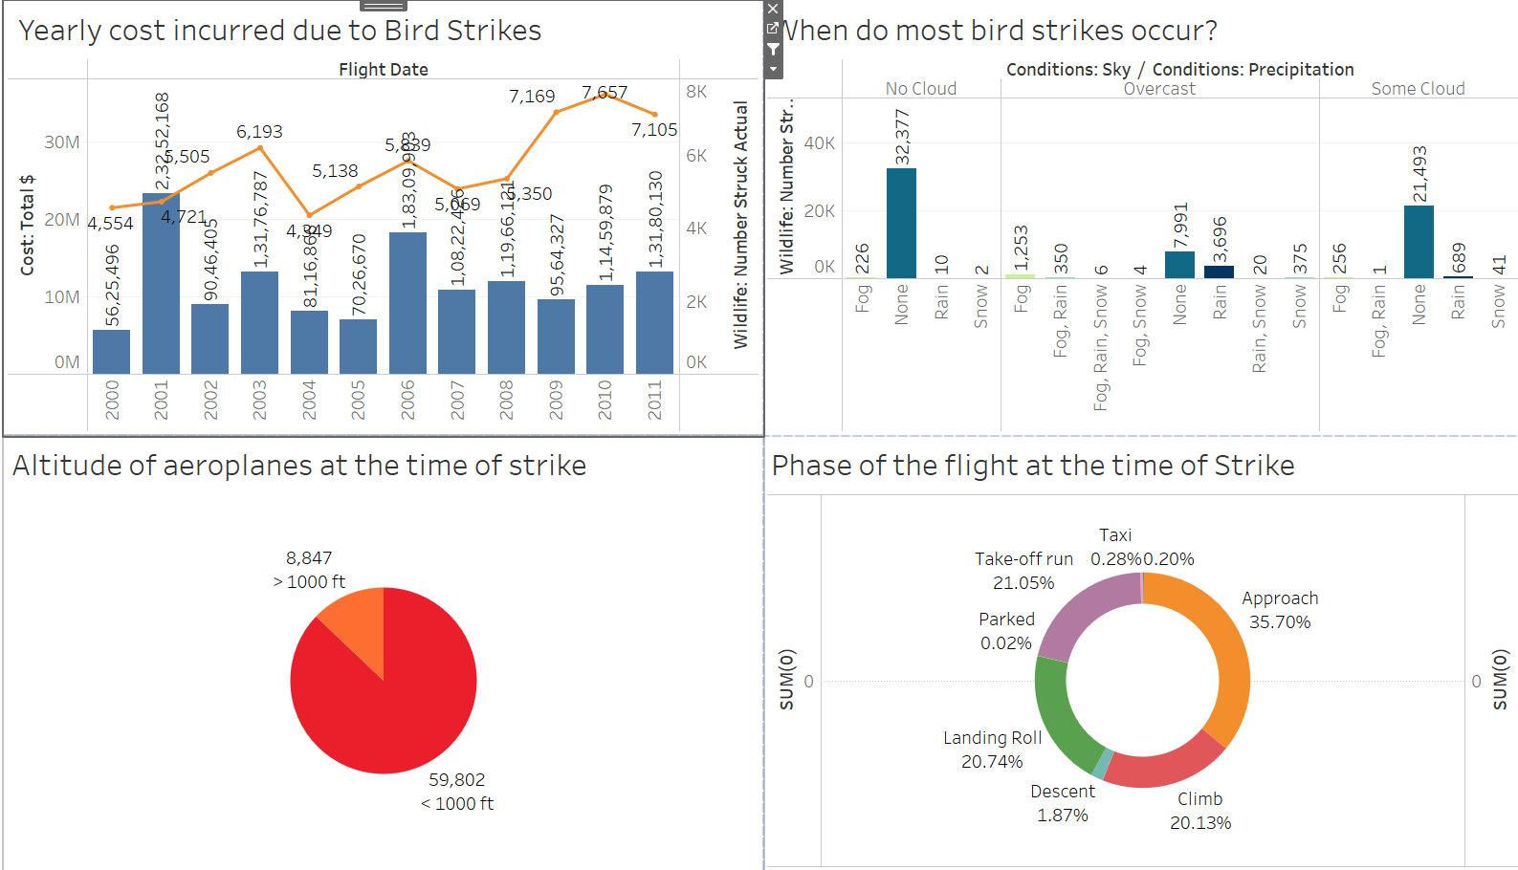
DASHBOARD 2

Slide 6
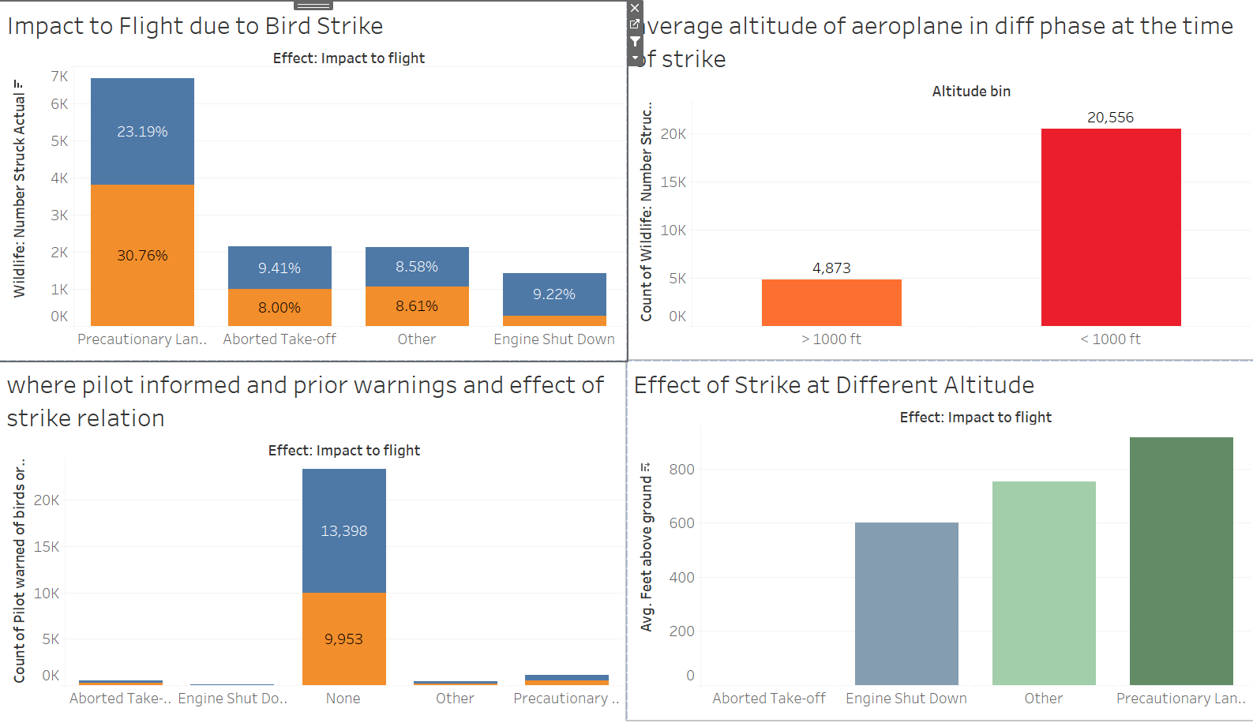
DASHBOARD 3

Slide 7
CONCLUSION
42.72% incidents where pilot was warned about the birds. Prior warning to the pilot reduces the risk of damage to the aircraft 52.78% of incidents have happened due to some small unknown bird. 72.9% incidents have happened when there is 1 bird/wildlife is struck in the airplane and caused damage.90.31% incidents caused no damage while 9.69% incidents caused damage80.84% of bird strike incidents have happened when the altitude of airplane was <1000 ft and 19.16% have happened when altitude was >1000 ft. Most of the incidents have happened when there is no cloud in each year.

